Slide 1

Future of DataComm
University of California, Berkeley
Department of Civil and Environmental Engineering
Professor Jasenka Rakas
Kevin Cheng | Ian Tai | Jeff Ma
Zhuo Chen | Steven Chua | Phil Tran
December 06, 2012

Slide 2
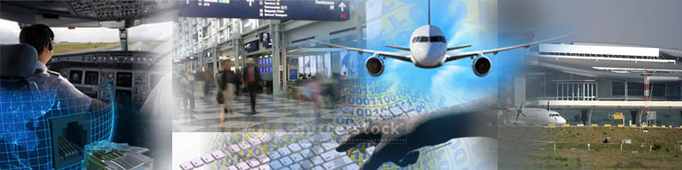
The NextGen Vision
A system that is based on satellite navigation and control, digital non-voice communication and advanced networking, and a sharing of decision making between the ground and the cockpit.
Notes:
2
They jointly created a vision for the Next Generation Air Transportation System (NextGen) that would modernize the NAS and take advantage of new automation and technologies to accommodate the expected growth of air transportation.

Slide 3
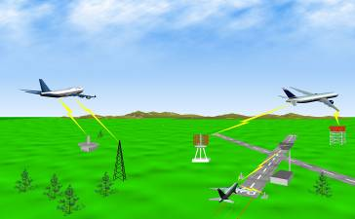
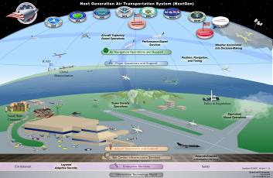
NextGen: Improving Efficiency & Capacity
Today’s NAS
NextGen
Ground-based Navigation and Surveillance
Air Traffic Control Communications By Voice
Disconnected Information Systems
Air Traffic “Control”
Fragmented Weather Forecasting
Airport Operations Limited By Visibility Conditions
Forensic Safety Systems
Satellite-based Navigation and Surveillance
Routine Information Sent Digitally
Information More Readily Accessible
Air Traffic “Management”
Forecasts Embedded into Decisions
Operations Continue Into Lower Visibility Conditions
Prognostic Safety Systems
Notes:
3
3
SLIDE #2
Also mention:
Safety is paramount.
Global harmonization is essential.
Environmental stewardship must be a focus.
We understand what must change in order to realize NextGen.
We are working to implement the foundational programs today, and define the future building blocks that enable mid- and far-term operational capabilities.
We have identified timelines and budgets to support them.

Slide 4
What is Data Comm?
Text-based communication that serves as an enabler for future NextGen concepts
Rough Analogy
Phone Calls : Text Messages
Radio Frequencies : DataComm
Notes:
Data Comm is designed around the basic principles listed on this slide:
First, Data Comm builds on the experience gained from CPCLC in Miami, over the Ocean, and through the European Link 2000 program to design a practical approach, implementing Data Communications in an incremental fashion (Data Comm is harmonized with Europe. We are leveraging the same Mode 2 technology being implemented by the Europeans for their initial and follow on data network).
Second, Data Comm is being designed to meet all safety requirements. (Design, performance requirements that are not extensible, we will build to meet Seg Two requirements from outset.)
Third, Data Comm is leveraging existing equipage such as Mode 2 avionics, and program plans include accommodating FANS.
Additionally, the Data Communications Program is working jointly with EUROCAE Working Group 78 through RTCA Special Committee 214 to develop avionics standards that will support all Data Comm capabilities through Segment Two to maximize airspace user benefits. We are expecting SC-214 to become the converged application for Europe and the US since the Europeans have indicated their plans to leverage SC-214 standards in their follow on data link implementation.

Slide 5
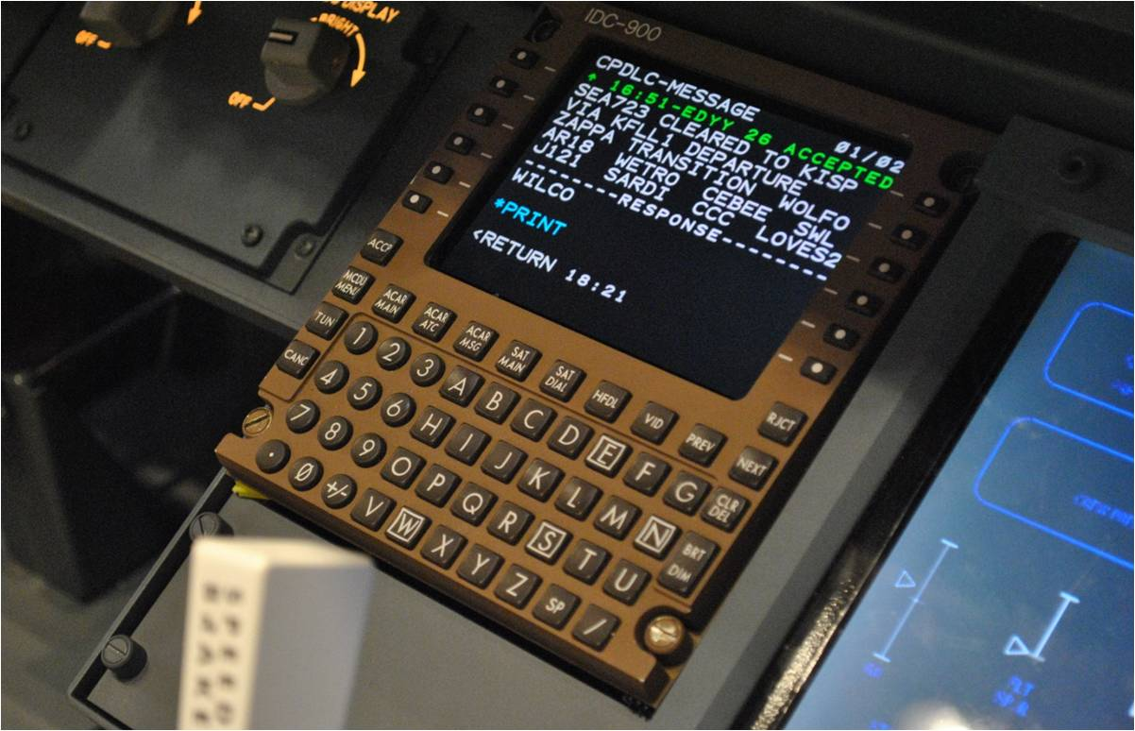

Slide 6
General DataComm Benefits
Reduces controller and pilot workload
Human memory less critical
Increases capacity of radio frequencies
Diminishes error and increases clarity
Presents unique advantages and applications

Slide 7
Data Comm: Challenges
Heads-down time
Party line loss
Passive readback
No information from tone of clearance/readback
Visual information overlooked?
Incoming Data Comm on FMS requires paging
away from current activity
to get full message
Aural alert may be insufficient & indistinguishable from other alerts
Mixed voice/Data Link may distract from one other
Controller must track multiple comms w/ delayed response times

Slide 8
Methodology: Our Approach
Literature Review
Human-factor via interviewing
Current uses of DataComm
Future of Data Comm
Generation of Innovative Ideas

Slide 9
Innovative Idea Generation
Collaborative idea generation for DataComm applications. With support and assistance from NASA, generation of brand new ideas, “out-of-the-box” or “crazy” ideas.
Members reviewed current uses and literature existing and developed ideas of future application utilizing DataComm, for Tower, TRACON, and En Route regions
Ideas Currently Developed:
Automated Tower Systems (ATS)
Deep Flight Deck Integration (DFDI)
Biomimicry – Flight Formation
Segregated Information Broadcast (SIB)
Automated Aircraft Reporting (AAR)
Notes:
Result may be due to different multiple processing “resources” associated with visual and auditory processing

Slide 10
Automated Tower System (ATS)
By: Ian Tai

Slide 11
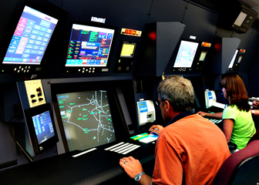
Introduction
Automated Tower System (ATS) → Motivation?
Air Traffic Control (ATC) Duties
Single point of communication
Sequencing, takeoffs, landings, taxiing
“…provide safe, orderly, expeditious flow of traffic” (FAA)
→ Without a tower or controller, these tasks fall to pilots themselves.

Slide 12
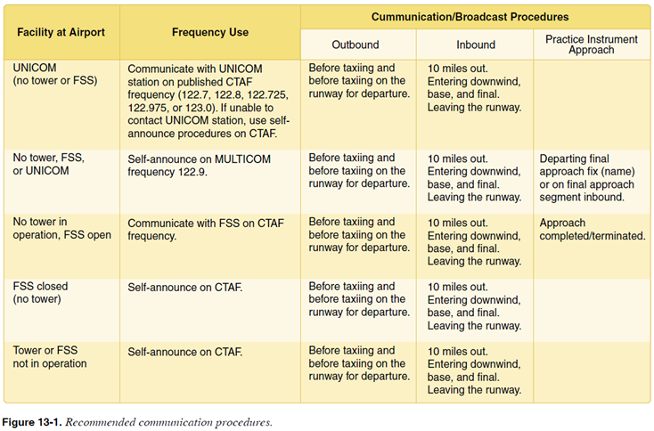
Non-Towered Airport Protocol
Facility at Airport
Frequency Use
Communication/Broadcast Procedures

Slide 13
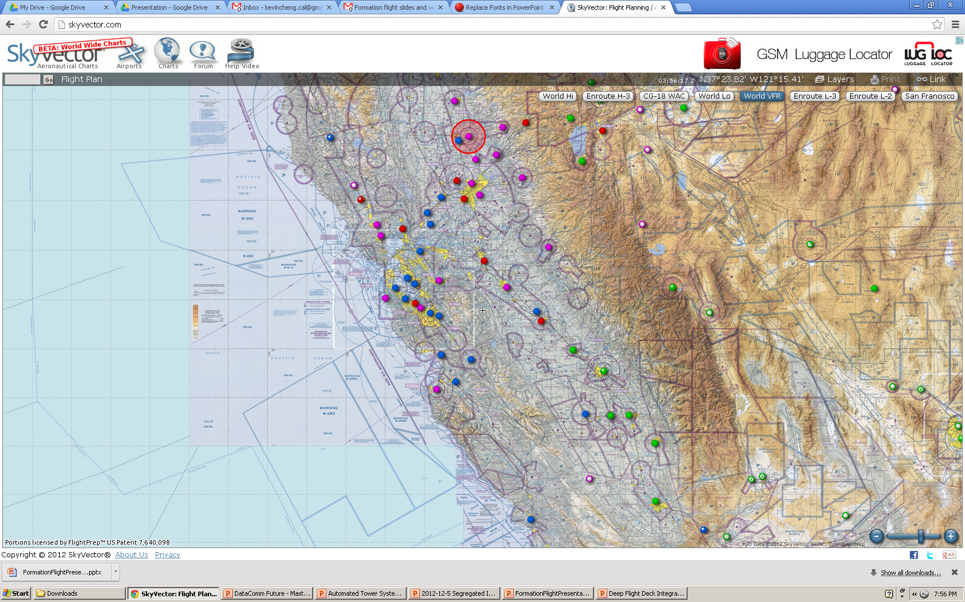
Non-towered Consequences
Congestion on CTAF
Lower situational awareness
No centralized communication
VFR for takeoff, landing, taxiing, sequencing
Multiple aircraft and aircraft type
Landings: same runway, different directions

Slide 14
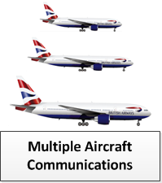
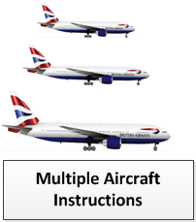
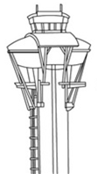
Air Side
Via DataComm
Via DataComm
Ground Side

Slide 15
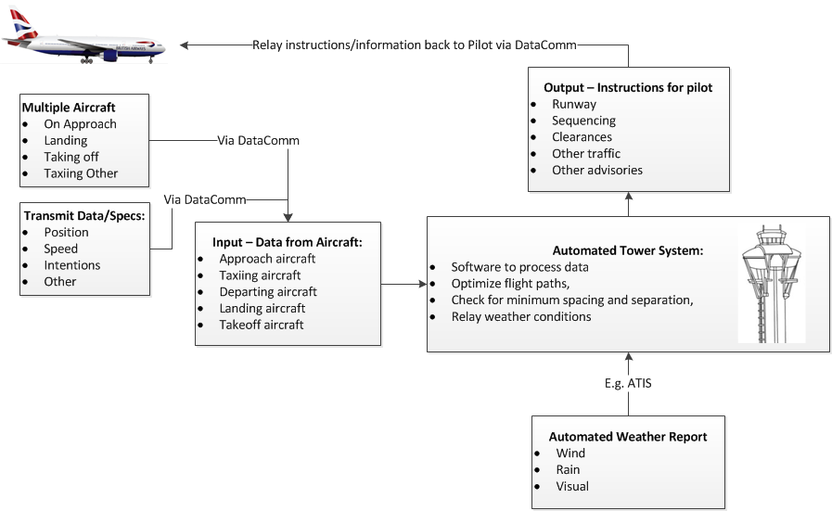
Detailed Flow Chart

Slide 16
Requisites for Implementation
Aircraft
Control Tower
Hardware for cockpit
DataComm compatible
Software for equipment.
Ability to read transmissions from Control tower and display instructions
Hardware for Control Tower, able to receive and relay DataComm messages
Software for control tower
Ability to input, process, and output data
Establish Standard Procedures and Protocol for ATS

Slide 17
Benefits of Automated Towers
Safety Benefits:
Streamlined situational awareness
Centralized communication, diminishes errors
Decreases congestion
Economical: ATS vs. building a tower or staffing
Diminishes human error

Slide 18
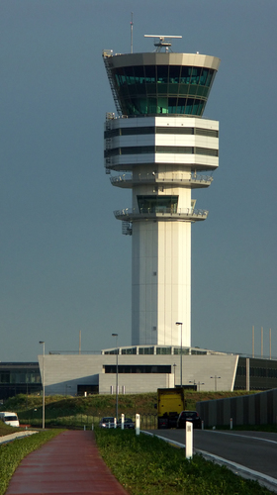
Summary
Automated Tower System, can directly use DataComm
Benefits: Safety and economical
Application to houred towers or non-towered airports
Future application to large airports

Slide 19
Data Link Deep Flight Deck Integration (DLDFDI)
By: Kevin Cheng

Slide 20
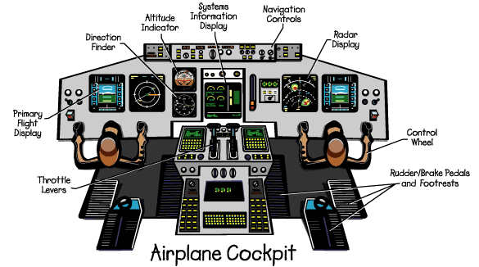
Background
Data Communications is primarily interacted with through the Multi-function Control and Display Unit (MCDU)

Slide 21
Background
Pros
Cons
Accurate Readback
Least disruptive to ongoing tasks
Information permanence
Diverts attention from visually critical areas
Chance of “forgetting” to resume task prior to ATC message
Decreased situational awareness
Data Communications → “Visual Attention Costs”

Slide 22
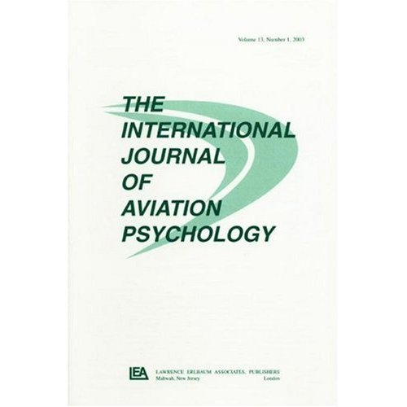
Background
Many studies performed on Data Communications aim to address the costs of visual attention diverted away from the instrument panel
Methods were introduced to eliminate or reduce the cost of visual attention by Data Communications
Introduced studies for a redundant text-voice format
“Cross-modal (auditory-visual) presentation yielded a more efficient performance than did intramodal (visual-visual) display information presentation.”
John R. Helleberg & Christopher D. Wickens (2003): Effects of Data-Link Modality and Display Redundancy on Pilot Performance: An Attentional Perspective, The International Journal of Aviation Psychology, 13:3, 189-210
Notes:
Result may be due to different multiple processing “resources” associated with visual and auditory processing

Slide 23




Problem, Engagement, and Methodology
Cross-modal (auditory-visual) display of communication poses a problem
“humans could only differentiate between five different sounds in a cockpit”
Lengthy readbacks can “step” on actual transmissions from ATC
Reducing audio clutter is an objective of Data Communications
Data Communications → “Auditory Clutter”

Slide 24
Problem, Engagement, and Methodology
Data Communications Today
“Auditory Clutter”
“Visual Attention Costs”
Our Approach:
Find a method of data communication transmission presentation that doesn’t increase audio clutter in cockpit and focuses attention on flight critical information

Slide 25
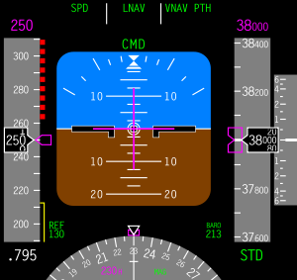
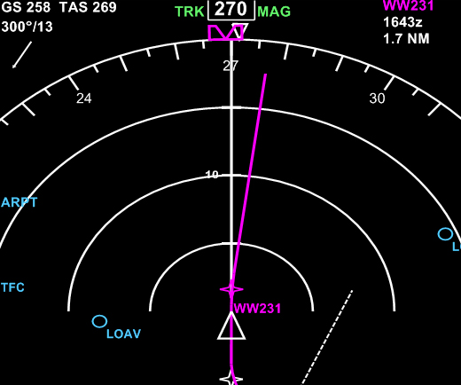
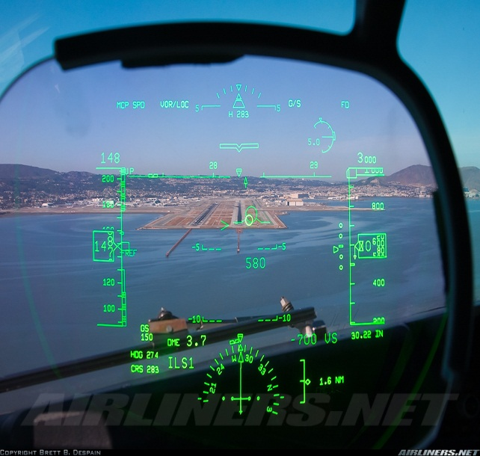
Problem, Engagement, and Methodology
Our Solution: Integrate data communication transmission into the flight critical visual areas to keep more focus on ongoing task
Deep Flight Deck Integration (DFDI)
Primary Flight Display
Navigation Display
Heads Up Display

Slide 26
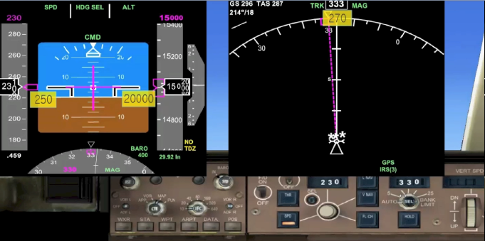
Deep Flight Deck Integration (DFDI)
Notes:
Present the information on the screen

Slide 27
DFDI solves Data Communication shortfalls
Cons
DFDI
Diverts attention from visually critical areas
Chance of “forgetting” to resume task prior to ATC message
Decreased situational awareness
Refocuses attention towards visually critical areas
Decreases chance of “forgetting” to resume ongoing task
Increases situational awareness
Notes:
Increases situational awareness

Slide 28
DFDI Demonstration

Slide 29
DFDI Benefits
Reduces “Visual Attention Costs”
Does not add to auditory clutter in the cockpit
Instructions displayed on the PFD and ND
Fewer memory and focus demands
Improves situational awareness

Slide 30
DFDI as a Future Concept Enabler
Automated Air Traffic System
Remote Aircraft Control
Phase 1:
Basic DFDI
Phase 4:
Automated airspace sector management with DFDI
Phase 2:
DFDI with reporting capabilities
Phase 3:
DFDI with automated conflict solving abilities
Notes:
NASA has its own objective → automate the entire air traffic system in addition to being able to control aircraft from the ground like a strategian
Of course, that’s not going to happen overnight → also, I’m a pilot too and I have issues with that cause that’ll put me out of a job…
But there are phases towards that goal
Here, to illustrate DFDI as a Future Concept Enabler, I am compounding DFDI and its evolution of capabilities to the phases that NASA will take to ultimately automate airspace.

Slide 31
Phase 1: Basic DFDI
NASA Objective | Reduce communication congestion
DFDI Capabilities | ATC Instructions integrated into the avionics
Communication Abilities | Ground→Air

Slide 32
Phase 2: DFDI With Reporting Capabilities
NASA Objective | Reduce communication congestion Improve predictability
DFDI Capabilities | ATC Instructions integrated into the avionics DFDI reports maneuver completion
Communication Abilities | Ground→Air Air→Ground
Notes:
We evolve DFDI to have reporting capabilities…once the pilot finishes the maneuver, DFDI reports this fact back to the controllers so they know that the sequence is done.

Slide 33
Phase 3: DFDI With Conflict Solving Abilities
NASA Objective | Reduce communication congestion Improve predictability Detect and solve conflicts automatically
DFDI Capabilities | ATC Instructions integrated into the avionics DFDI reports maneuver completion DFDI auto-solves trajectory conflicts
Communication Abilities | Ground→Air Air→Ground Reports and suggests maneuvers to controller
Notes:
If NASA’s next objective is to detect and solve conflicts automatically, then DFDI will evolve and also assist with auto-solving trajectory conflicts…
For example, through VDL Mode 4, aircraft will talk to each other and figure out how best they will solve their own conflicts. The controller takes a passive role and only monitors this sequence.

Slide 34
Phase 4: DFDI With Automated Sector Management Abilities
NASA Objective | Reduce communication congestion Improve predictability Detect and solve conflicts automatically Automate airspace sectors
DFDI Capabilities | ATC Instructions integrated into the avionics DFDI reports maneuver completion DFDI auto-solves trajectory conflicts DFDI manages airspace
Communication Abilities | Ground→Air Air→Ground Reports and suggests maneuvers to controller Air→Air/Ground communication
Notes:
Lastly, as we get closer to airspace automation, we expand the last idea into a whole airspace sector.
Aircraft will talk to each other and generate full trajectories on how they will navigate the airspace. DFDI will help with that when it provides suggestions on the avionics.

Slide 35
Biomimicry – Formation Flight
By: Steven Chua

Slide 36

Source: Airbus
Notes:
Flying at a given spot in the wake of another aircraft can decrease
induced drag

Slide 37
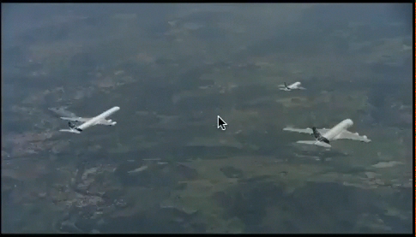

Slide 38
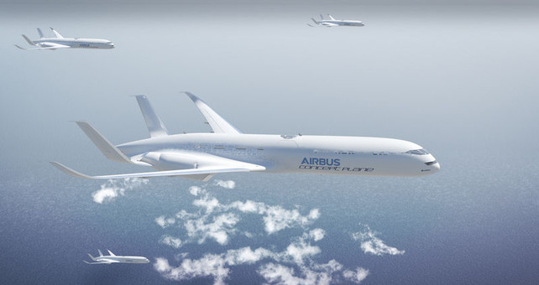
Source: Airbus

Slide 39
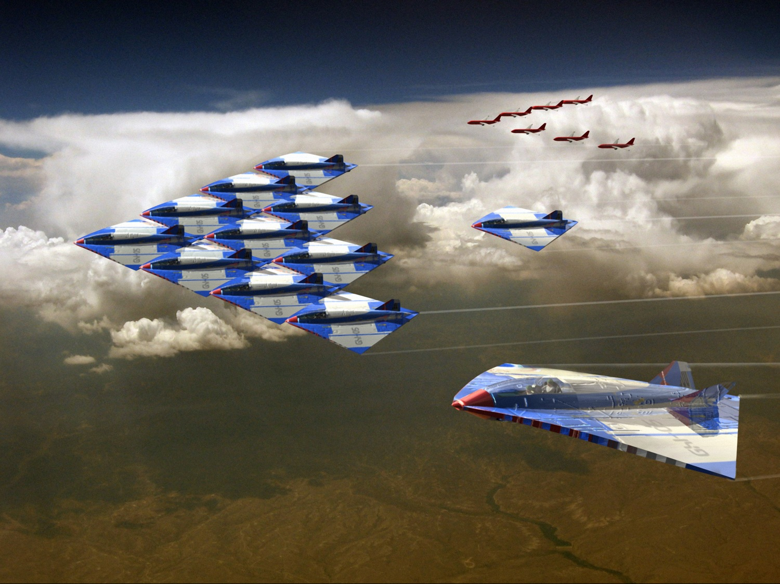
Source: Airbus

Slide 40
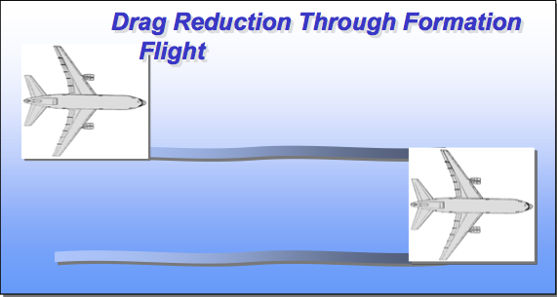
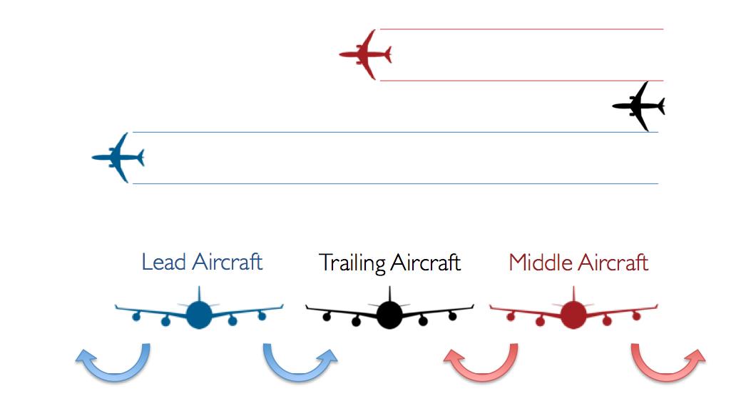
Formation Flight Benefits
Source: Greg Larson
Source: Andrew Ning
FutureComm
Background | Problem | DataLink| Applications| Case Study| Future
Notes:
Why now?
– New advances in software and GPS have enabled position- keeping
• NASA AFF program
– World air cargo traffic growing on average 6.4% per year in the next 20 years
• Asian market growing at 10.3%
– Fuel prices increasing (44% over the past year) • Demand for technology to lower fuel costs • Fuel costs normally 12-18% of total airline costs

Slide 41
Formation Flight Benefits
Air Cargo Carriers
Cargo carriers save money
Reduced prices capture market share, increase profit
Increased range reaches additional markets, more profit
FutureComm
Background | Problem | DataLink| Applications| Case Study| Future
Notes:
For Air cargo carriers:
– Cargo carriers save money
– Reduced prices capture market share, increase profit
– Increased range reaches additional markets, more profit

Slide 42
Formation Flight Benefits
Commercial Airlines
Reduces air traffic en-route
Will lead to autonomous formation take-off and landing to reduce airport congestion.
FutureComm
Background | Problem | DataLink| Applications| Case Study| Future
Notes:
For Air cargo carriers:
– Cargo carriers save money
– Reduced prices capture market share, increase profit
– Increased range reaches additional markets, more profit

Slide 43
Formation Flight Benefits
Commercial Airlines
Reduces air traffic en-route
Will lead to autonomous formation take-off and landing to reduce airport congestion.
FutureComm
Background | Problem | DataLink| Applications| Case Study| Future
Notes:
For Air cargo carriers:
– Cargo carriers save money
– Reduced prices capture market share, increase profit
– Increased range reaches additional markets, more profit

Slide 44
Formation Flight Benefits
Environment
Reduction of aircraft emissions and effects of global warming.
FutureComm
Background | Problem | DataLink| Applications| Case Study| Future
Notes:
For Air cargo carriers:
– Cargo carriers save money
– Reduced prices capture market share, increase profit
– Increased range reaches additional markets, more profit

Slide 45
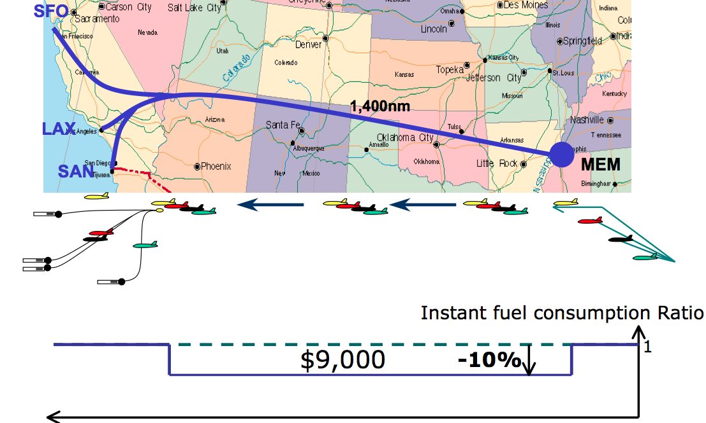
Formation Flight Case Stuydy
FutureComm
Background | Problem | DataLink| Applications| Case Study| Future
Notes:
Why now?
– New advances in software and GPS have enabled position- keeping
• NASA AFF program
– World air cargo traffic growing on average 6.4% per year in the next 20 years
• Asian market growing at 10.3%
– Fuel prices increasing (44% over the past year) • Demand for technology to lower fuel costs • Fuel costs normally 12-18% of total airline costs

Slide 46
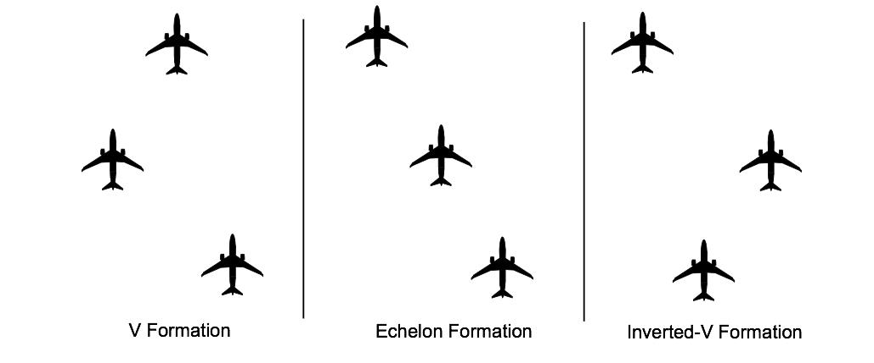
Formation Flight Types
Source: Andrew Ning
FutureComm
Background | Problem | DataLink| Applications| Case Study| Future

Slide 47
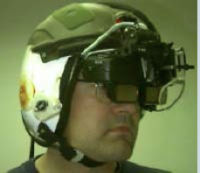
Formation Flight made possible through Datalink by…
Providing pilot information on probability of collisions and when to resume control when on autopilot.
Device can be sensory such as a Head Mounted Display.
Source:NAMRL
FutureComm
Background | Problem | DataLink| Applications| Case Study| Future

Slide 48
Formation Flight made possible through Datalink by…
Each aircraft determines it’s own position via GPS and sends information to other aircraft via pilot to pilot datalink
Wireless datalink to determine if an aircraft is within range of formation
FutureComm
Background | Problem | DataLink| Applications| Case Study| Future

Slide 49
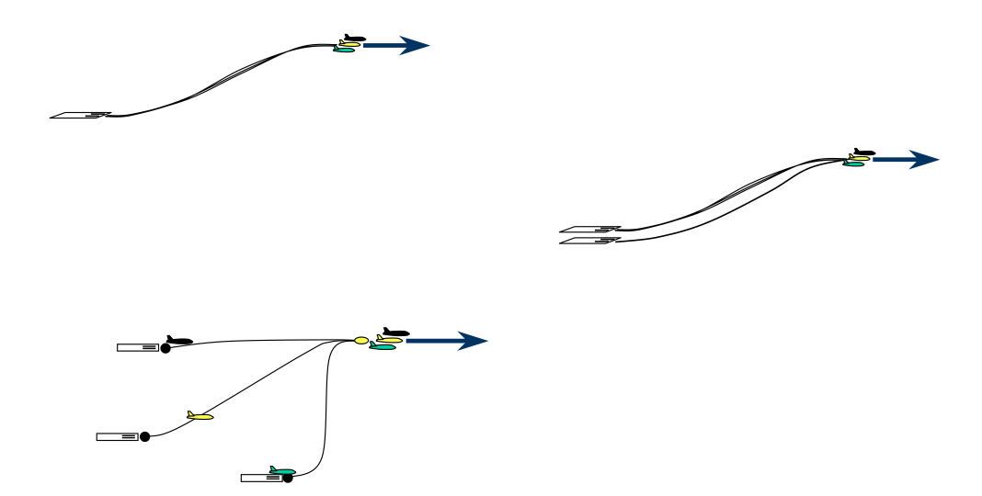
Formation Flight Takeoff
Source: MIT
FutureComm
Background | Problem | DataLink| Applications| Case Study| Future

Slide 50
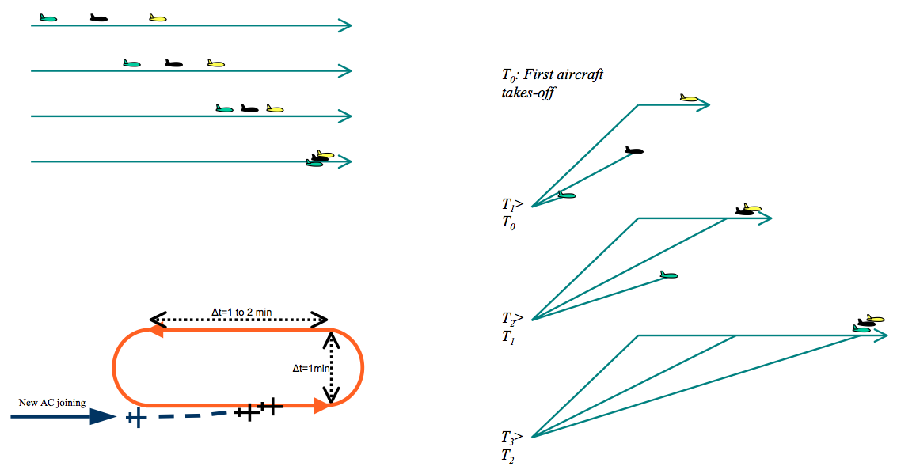
Formation Flight Join-up
Source: MIT
FutureComm
Background | Problem | DataLink| Applications| Case Study| Future

Slide 51
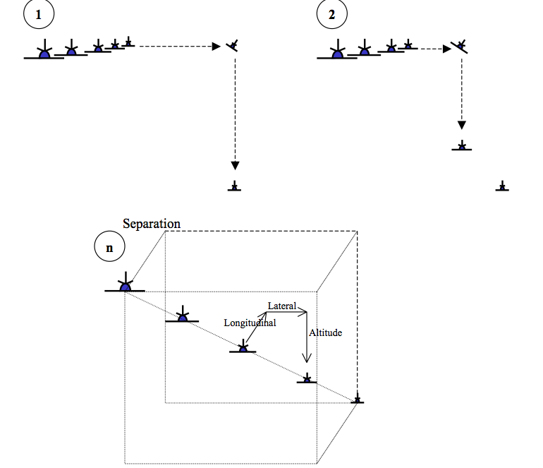
Formation Flight Breakaway
Source: MIT
FutureComm
Background | Problem | DataLink| Applications| Case Study| Future

Slide 52
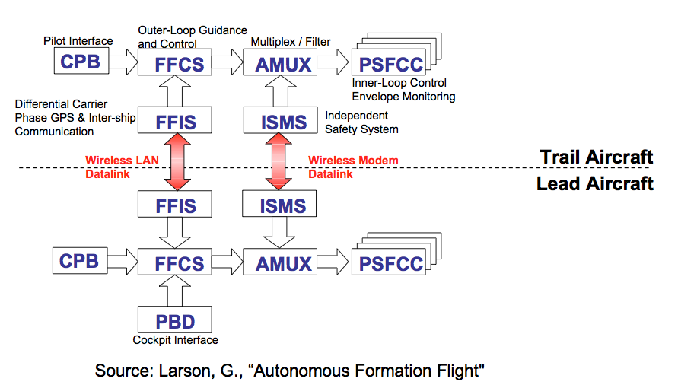
Autonomous Formation Flight (AFF) System Architecture
FutureComm
Background | Problem | DataLink| Applications| Case Study| Future

Slide 53
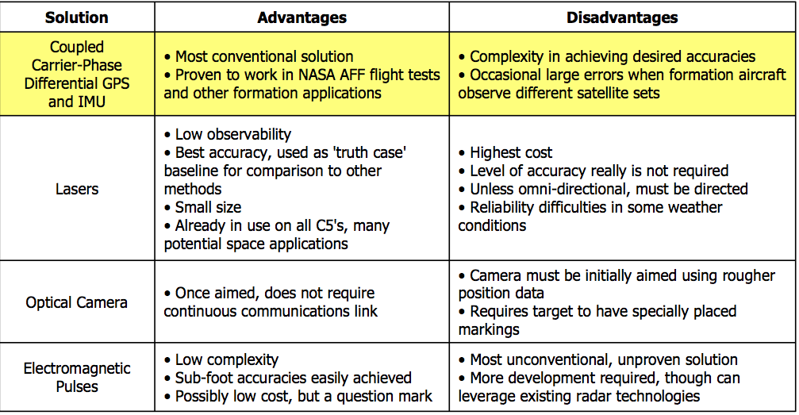
Datalink and Differential GPS for Position Sensing
Source: NASA
FutureComm
Background | Problem | DataLink| Applications| Case Study| Future

Slide 54
VDL Mode 4 supporting surveillance
Position reports
ADS-B
Cockpit display
CDTI
Air Traffic Control
Notes:
In an ADS-B system each aircraft/vehicle is periodically broadcasting position and additional information. These transmissions are available for everyone who are properly equipped, i.e surrounding aircraft/vehicles, ATC and AOC centres. The received information is typically displayed on Cockpit Display Traffic Display (CDTI) in cockpit giving pilots information on the situation surrounding their own aircraft. The position data is also typically presented on controller’s displays.

Slide 55
Cockpit display (CDTI) – airborne situation
Gives pilot a display of
surrounding traffic

Slide 56
Cost/Benefit Analysis
Variable | Advantages | Drawbacks
↑ precision | ↓ drag | ↑ cost
↑ system integration level | ↑ precision | ↑ cost ,↑ risk ↑ development time
↑ new technologies | ↑ precision | ↑ risk, ↑ cost
↑ no. of aircraft in formation | ↓ drag ↓ congestion | ↑ ATC separation ↓ string stability ↑ controller workload
↑ types and no. of aircraft certified to fly in formation | ↑ operational flexibility | ↑ size of test matrix ↑ mapping matrix ↑ time to certify
↑ ATC separation buffer | ↑ safety | ↑ congestion

Slide 57
Datalink Control Architecture
Centralized Leader-Follower:
Has single leader plane within the formation that issues commands to all other aircraft
Leader:
Receives relative and absolute state information from all other planes
Acts as DGPS base station
Issues commands designed to:
Maintain formation shape with other planes
Anticipate future planned maneuvers and changes.
Followers:
Receives state communication from leader and calculates to execute.
Sends aircraft state info to leader.
FutureComm
Background | Problem | DataLink| Applications| Case Study| Future

Slide 58
Emerging Services: Next Steps for us
Tailored Arrivals
Optimized arrival profile up-linked to aircraft and loaded into FMS
Waypoint Management
Managed in-flight spacing using Data Comm for delivery of control times at strategic points
4-D Trajectory Optimization
Enhancements to flight profiles are negotiated via CPDLC
ADS-C Oceanic In-Trail Procedures
Separation down to 15NM for climb and descent through a blocking aircraft, and
FutureComm
Background | Problem | DataLink| Applications| Case Study| Future

Slide 59
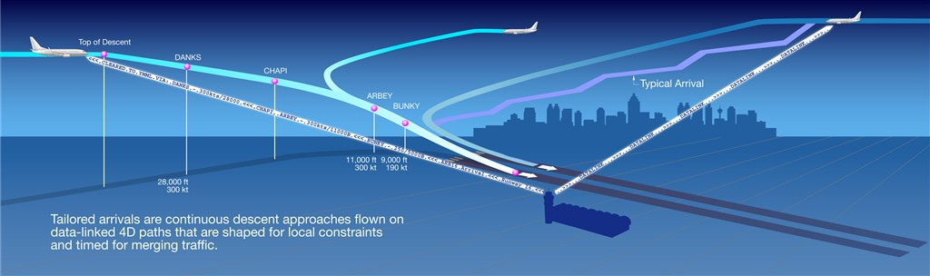
Next Steps:
Tailored Arrivals.
Continuous Descent Approaches (CDA) and (Required Time of Arrival – RTA’s ) commmunicated through datalink.

Slide 60
Segregated Information Broadcast (SIB)
By: Jeff Ma

Slide 61
The Party line Effect
Radio Communication
Benefit of Eavesdropping
Datalink
Loss of situational awareness

Slide 62
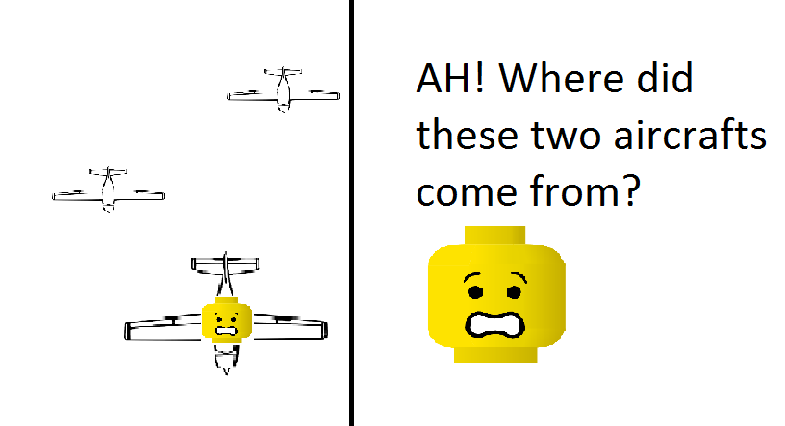
Situational Awareness

Slide 63
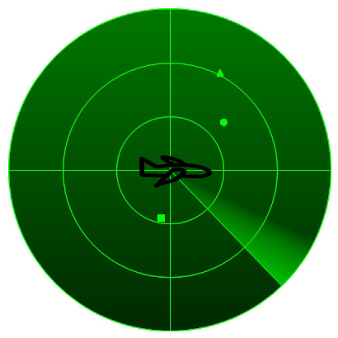
SIB by Sectors

Slide 64
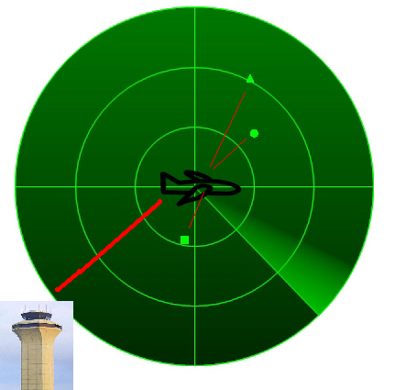
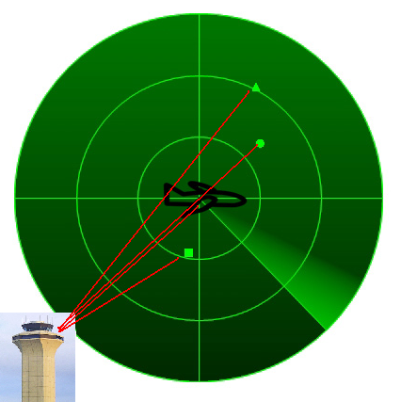
SIB by Sectors

Slide 65
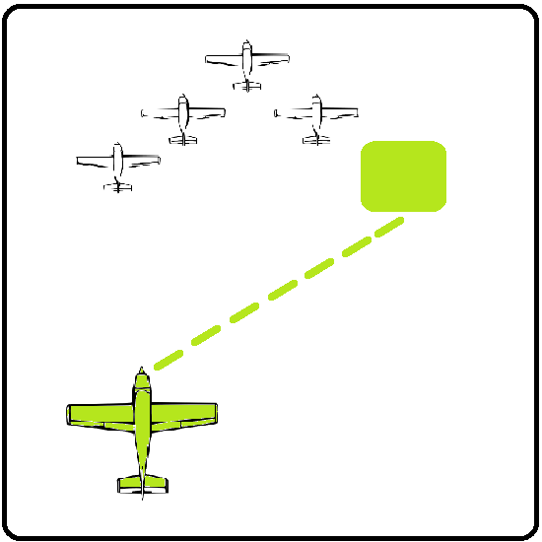
SIB by Groups
(1800) ATC: Southwest79 to join formation. Accept?
(1802) Southwest79 Accepts.
(1802) ATC: Increase speed by 10 knots and turn 5 degrees to the right.
ATC receives automated msg when pilot complete manuever
ATC: Decrease Elevation by 500meters
ATC receives automated msg when pilot complete manuever
…
Flight Formation

Slide 66
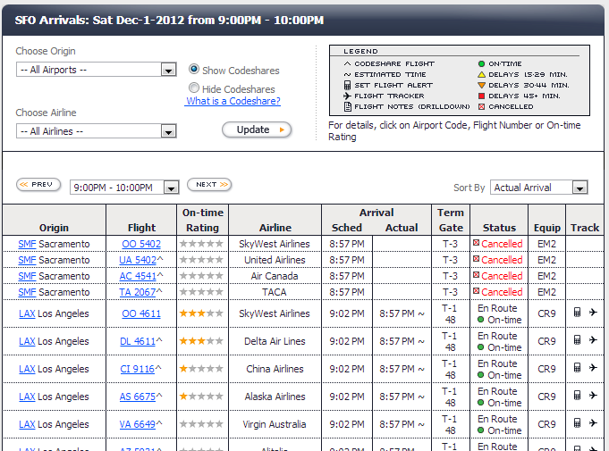
SIB by Destination
http://www.flightstats.com/go/FlightStatus/flightStatusByAirport.do

Slide 67
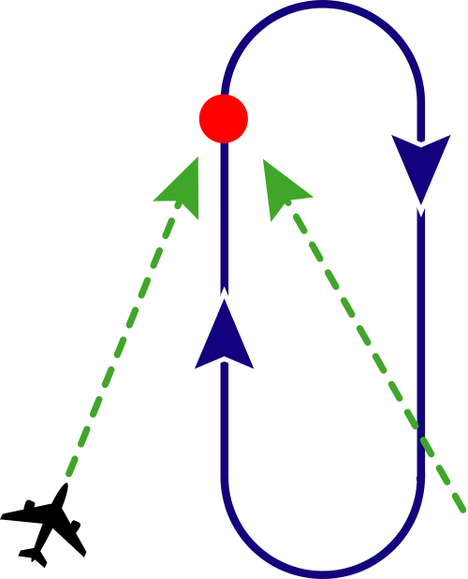
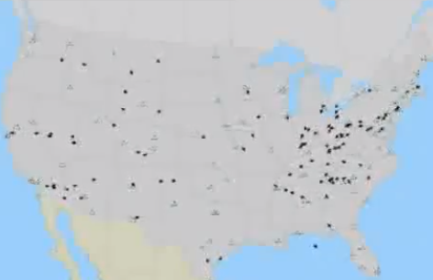
SIB by Destination: Airport Witholding Procedure

Slide 68
SIB
Summary and Benefits
Situational Awareness of Pilots
Fuel savings

Slide 69
Conclusion
DataComm has many unique advantages, but also many challenges associated
Change in National Air System is more “evolution than revolution” (F. Ketcham)
Continual Development of innovative ideas to further NextGen
Continual research into NextGen enablers to improve current system

Slide 70

Thank you! Questions?

